Slide 1
Directions
Come in silently
Sit down without talking
Face the screen
Show that you are ready to learn

Slide 2
C Jam Blues
Duke Ellington

Slide 3
Objectives
Students will read the note C
Students will improvise pitch to a given rhythm.
Students will become familiar with the work of Duke Ellington through active listening.

Slide 4
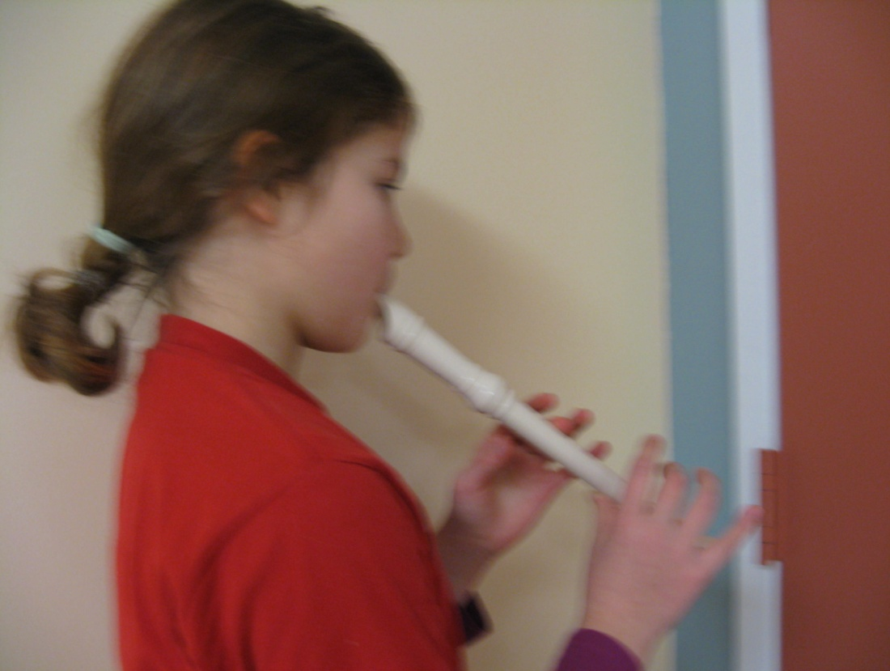
Three Points of contact
Mouth
Left Middle Finger
Right Thumb

Slide 5
Practice in chin position:

Slide 6
Two more helpful notes:

Slide 7
C Jam Blues
C
F
C
G
C

Slide 8
Substitute E, G or A for the last note

Slide 9
Substitute A for any of these G’s

Slide 10
You are improvising!
Improvising means making choices about the notes….

Slide 11
How did you do?
Did you learn how to read “C”?
Did you improvise?
Did you learn about jazz great Duke Ellington?

